Slide 1


Denver Broncos:
A Traveling Salesman Problem
David Graves
Colorado State University Global
CSC506
Dr. Brian Holbert
May 5, 2025

Slide 2
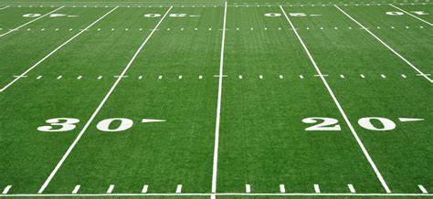

Project Goal
This project was designed to explore different algorithmic implementations to find the best, or shortest route for the Denver Broncos to take and identify the most efficient algorithmic performance as they take on Division rivals and other AFC teams.
Traveling Salesman Problem: “The problem faced by a salesperson who needs to visit a number of customers located in different cities and tries to find the shortest round trip accomplishing this task.” (Hoos & Stutzle, 2005)
Test Algorithms
  Nearest Neighbor
  Minimum Spanning Tree
  Genetic
Test Maps include 4, 8 and 12 city maps (Data sets A,B & C detail slide 3)
  Maps increase in complexity A->B->C to measure performance
  Straight-Line Distance measured in miles between cities

Slide 3
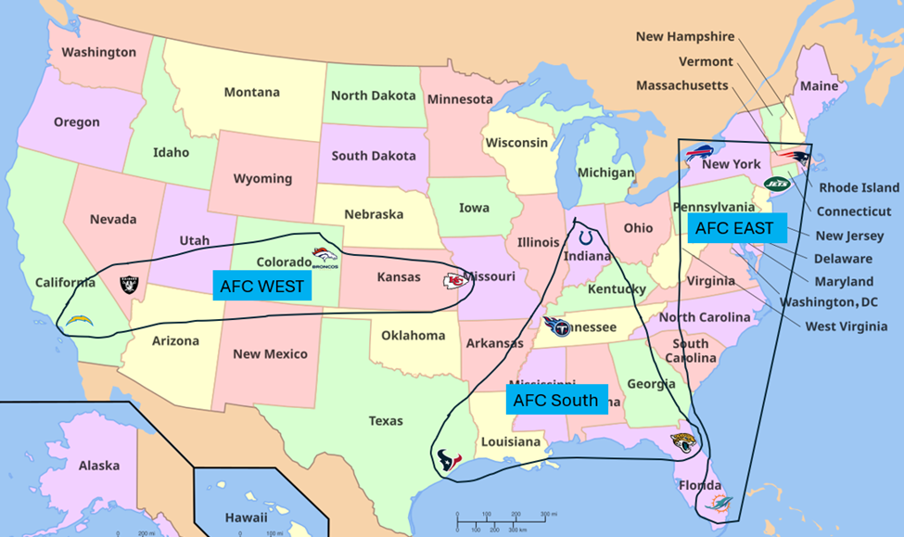
Methodology
Develop and run each algorithm across each Data Set A, B and C.
  Track and Print speed to completion of program.
  Track and Print resulting Maps of each algorithmic output.
Data Set A = Denver, Kansas City, Las Vegas & Los Angeles.
Data Set B = Data Set A + Buffalo, New York, New England & Miami.
Data Set C = Data Set’s A & B + Jacksonville, Houston, Nashville & Indianapolis.

Slide 4



Data Set A – 4 city
Nearest Neighbor
MST
Genetic
Algorithm | Map | Distance | Execute Time
Nearest Neighbor | DEN-KC-LV-LA-DEN | 2798 miles | 0.0006 seconds
MST | DEN-KC-LV-LA-DEN | 2798 miles | 0.0005 seconds
Genetic | DEN-LV-LA-KC-DEN | 2793 miles | 0.7763 seconds
* Full Code shared Separately

Slide 5
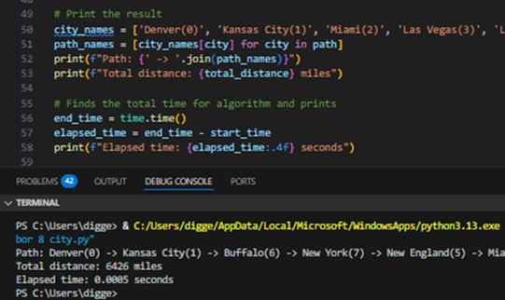
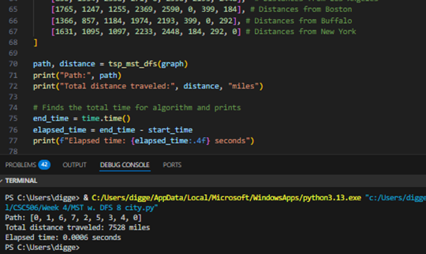

Data Set B – 8 city
Nearest Neighbor
MST
Genetic
Algorithm | Map | Distance | Execute Time
Nearest Neighbor | DEN-KC-BUF-NY-NE-MIA-LV-LA-DEN | 6426 miles | 0.0005 seconds
MST | DEN-KC-BUF-NY-MIA-NE-LV-LA-DEN | 7528 miles | 0.0006 seconds
Genetic | DEN-LA-LV-BUF-NE-NY-MIA-KC-DEN | 6554 miles | 1.3282 seconds
* Full Code shared Separately

Slide 6
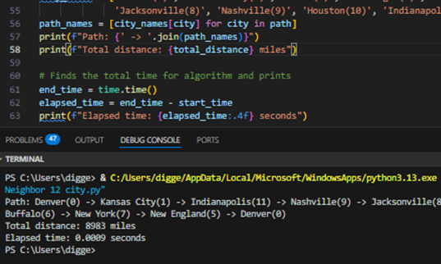
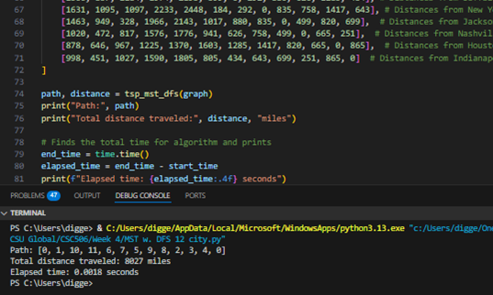

Data Set C – 12 city
Nearest Neighbor
MST
Genetic
Algorithm | Map | Distance | Execute Time
Nearest Neighbor | DEN-KC-IND-NSH-JAC-MIA-HOU-LV-LA-BUF-NY-NE-DEN | 8983 miles | 0.0009 seconds
MST | DEN-KC-HOU-IND-BUF-NY-NE-NSH-JAC-MIA-LV-LA-DEN | 8027 miles | 0.0018 seconds
Genetic | DEN-LV-LA-KC-MIA-JAC-IND-NSH-HOU-NY-NE-BUF-DEN | 8787 miles | 1.6809 seconds
* Full Code shared Separately

Slide 7

Genetic Changes
After initial review of results; I made an update to the ‘Generations’ variable within the Genetic algorithm reducing its output from 500 to 250 generations while keeping the population size and mutation rate the same, then ran the algorithm against the most complex 12-city map and found better distance results against competing algorithms (including previous Genetic Version) and halved the time to completion.
Genetic 1.1
Data Set C - Rerun
Algorithm | Map | Distance | Execute Time
Nearest Neighbor | DEN-KC-IND-NSH-JAC-MIA-HOU-LV-LA-BUF-NY-NE-DEN | 8983 miles | 0.0009 seconds
MST | DEN-KC-HOU-IND-BUF-NY-NE-NSH-JAC-MIA-LV-LA-DEN | 8027 miles | 0.0018 seconds
Genetic | DEN-LV-LA-KC-MIA-JAC-IND-NSH-HOU-NY-NE-BUF-DEN | 8787 miles | 1.6809 seconds
Genetic 1.1 | DEN-LA-LV-HOU-MIA-JAC-NE-NY-BUF-NSH-IND-KC-DEN | 6999 miles | 0.6417 seconds
* Full Code shared Separately

Slide 8
Analysis & Outcome
Data Set | Algorithm | Map | Distance Traveled | Time to Execute
A | Nearest Neighbor | DEN, KC, LV, LA, DEN | 2798 miles | .0006 seconds
 | Minimum Span Tree | DEN, KC, LV, LA, DEN | 2798 miles | .0005 seconds
 | Genetic | DEN, LV, LA, KC, DEN | 2793 miles | .7763 seconds
B | Nearest Neighbor | DEN, KC, BUF, NY, NE, MIA, LV, LA, DEN | 6426 miles | .0005 seconds
 | Minimum Span Tree | DEN, KC, BUF, NY, MIA, NE, LV, LA, DEN | 7528 miles | .0006 seconds
 | Genetic | DEN, LA, LV, BUF, NE, NY, MIA, KC, DEN | 6554 miles | 1.3282 seconds
C | Nearest Neighbor | DEN, KC, IND, NSH, JAC, MIA, HOU, LV, LA, BUF, NY, NE, DEN | 8983 miles | .0009 seconds
 | Minimum Span Tree | DEN, KC, HOU, IND, BUF, NY, NE, NSH, JAC, MIA, LV, LA, DEN | 8027 miles | .0018 seconds
 | Genetic | DEN, LV, LA, KC, MIA, JAC, IND, NSH, HOU, NY, NE, BUF, DEN | 8787 miles | 1.6809 seconds
 | Genetic1.1 | DEN, LA, LV, HOU, MIA, JAC, NE, NY, BUF, NSH, IND, KC, DEN | 6999 miles | 0.6417 seconds
Key Takeaways:
For small ‘simple’ data sets; Nearest Neighbor and/or Minimum Spanning Tree are good options that produce quality maps in an efficient manner. Genetic produces good maps less efficiently.
For medium ‘somewhat complex’ data sets; Nearest Neighbor produces good maps efficiently but Genetic could also be a good option here too if efficiency isn’t a concern.
For large ‘complex’ data sets; Genetic can provide some of the best maps if variables like Mutation Rate, Generation and Population are set appropriately. The value seen in better mapping makes this option the best even with the expanded computation time.

Slide 9
Other Use Cases
Nearest Neighbor
Easy to implement and is fast when used for small instances.
Fraud Detection: Identify anomalies in transactional data. (Mongodb.com, 2025)
Content-Based Recognition: Recommends like items based on what a user has previously interacted with.
Minimum Spanning Tree
Good option for managing data sets when efficiency is a large concern.
Network Management: Prevent broadcast storms caused by loops. (Tsinovoi, 2025)
Image Processing: Useful in object recognition and image analysis.
Genetic
Best chance to find optimal solutions for large and complex problems.
Healthcare: Provide better patient care and reduce treatment costs.
Manufacturing: Identify inefficiencies in production processes. (Wadsworth, 2023)

Slide 10
Personal Reflection
Like many other facets in algorithmic design and analysis there are myriad ways to solve problems like “The Traveling Salesman”. This exercise has underscored the importance of understanding what tool to use to maximize the output and manage the cost in development and computing.
Fit For Purpose:
This experiment drove home the importance of understanding what outcomes one is looking for while considering cost in accuracy and performance and I now have a greater knowledge of the benefits and challenges each of the three algorithms, Nearest Neighbor, Minimum Spanning Tree, and Genetic when used against varying levels of complexity within data sets.
After performing this work, I can reasonably offer a recommendation on what type of algorithm should be used based on criteria including size and complexity of input as well as expected output for problems like TSP.

Slide 11
Appendix

Slide 12
References
- Hoos, Holger & Stutzle, Thomas (2005). Sciencedirect.com. In the Morgan Kaufman Series in Artificial Intelligence.
https://www.sciencedirect.com/science/article/pii/B9781558608726500184
Mongodb.com (2025). What is K-Nearest Neighbors (KNN) Search?
    https://www.mongodb.com/resources/basics/knn-search
Tsinovoi, Edward (2025). Ioriver.io. Spanning Tree Protocol.
    https://www.ioriver.io/terms/spanning-tree-protocol#:~:text=STP%20is%20essential%20for%20preventing,path%20fails%2C%20ensuring%20network%20reliability.
Wadsworth, Richard (2023, March 22). Contino.io. Optimising Business Processes: The Darwinian Way to Better Decision Making.
https://www.contino.io/insights/optimising-business-processes-using-genetic-algorithms

